Slide 2
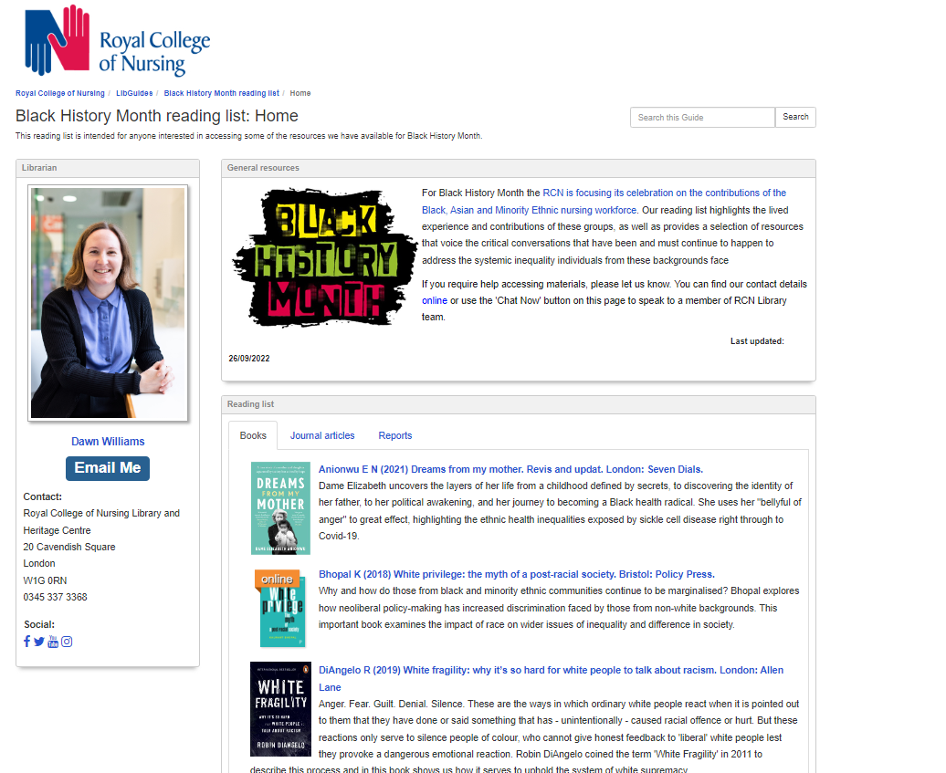
RCN Library BHM Reading List on Anti-Racism 2023

Slide 3
Hidden in Plain Sight Celebrating Nursing Diversity. Online exhibition (originally 2017)

Slide 4
RCN Library and Archive Service Online Talks​
In collaboration with the RCN History of Nursing Forum
The Language of Race Discrimination- what's appropriate? A joint panel from the RCN and NHS confederation explored the history of language and race discrimination with a focus on healthcare management and nursing. The event took place in the context of #NHS75 and Windrush commemorations (2023)

Slide 5
A History of Sickle Cell Disease and Race in the NHS - historian Grace Redhead, specialist nurse consultant and RCN Fellow Lola Oni, and nurse and sickle cell patient Gildé Nsianguana, explores the history of sickle cell and race in the UK, and the continued need for better health care (2022)
Yatdjuligin - Training the 'Natives' as Nurses: Voices from the Colony Professor Odette Best, on Aboriginal women from Queensland Australia as Registered Nurses at the RCN History of Nursing Annual Lecture (2022)
TIm Kirby on 30 Barbados nurses coming to the UK late 40s / 50s Teresa Doherty on family history source for black nurses in the UK (2021)

Slide 6
David Harewood in conversation with Simon Arday and Kojo Bonsu exploring what it means to be a person of colour navigating the mental health system (2021)
Karen Flynn on Black Caribbean and Canadian women in nursing part of a panel on iconic history of nursing books
Erin Spinney on Black Nurses, Enslaved Labour, and the Royal Navy, 1790-1820 (2021)
Claire Chatterton & Estephanie Dunn on Nursing Whilst Black, black nurses in history (2020)

Slide 7
Kaitlene Koranteng & Debrah Igbinedion on history of black health workers project by the UK Young Historians Project (2020)
Yvonne Coghill Celebrating Nursing Diversity launching the Hidden in Plain Sight Exhibition (2017)
Elizabeth Anionwu in conversation with Wendy Irwin to launch Elizabeth’s memoir (2017)

Slide 8
RCN History of Nursing Forum
Welcomes RCN members who are interested in history of nursing – to find out more visit their webpages which includes a link to join them via MyRCN
The forum runs a number of activities including oral history interviews, Wikipedia articles, events and a series of articles in RCN Bulletin.
Young Historians Project – uncovering black nursing history (2020)

Slide 9
Nursing whilst black | Royal College of Nursing (rcn.org.uk)
Nursing Whilst Black is part of a podcast series by the Royal College of Nursing (c.2019). It aimed to showcase the diversity of voices across nursing today.
In this series we asked nurses, healthcare support workers and students from Black, Asian and minority ethnic backgrounds to share their thoughts, reflections and insights on their lived experiences of working in healthcare and provide some recommendations about how we can all be better equipped to tackle issues of race and racism in the profession.

Slide 10
Social Media – useful tags and accounts
#RCNBHM2023
#BlackHistory
#BlackHistoryMonth
#HistNursing
Twitter - @RCNHistory @RCNLibraries

Slide 11
Images
Below we have a small selection of copyright cleared photographs that can be used in RCN presentations or publications.
Please use the reference and copyright statement that appears in the notes when using these images.
If anyone wants to use these for non-RCN purposes; they need to contact archives@rcn.org.uk for a license.

Slide 12
Notes:
Still from Primary Health Care film c.1985 © RCN Archives

Slide 13
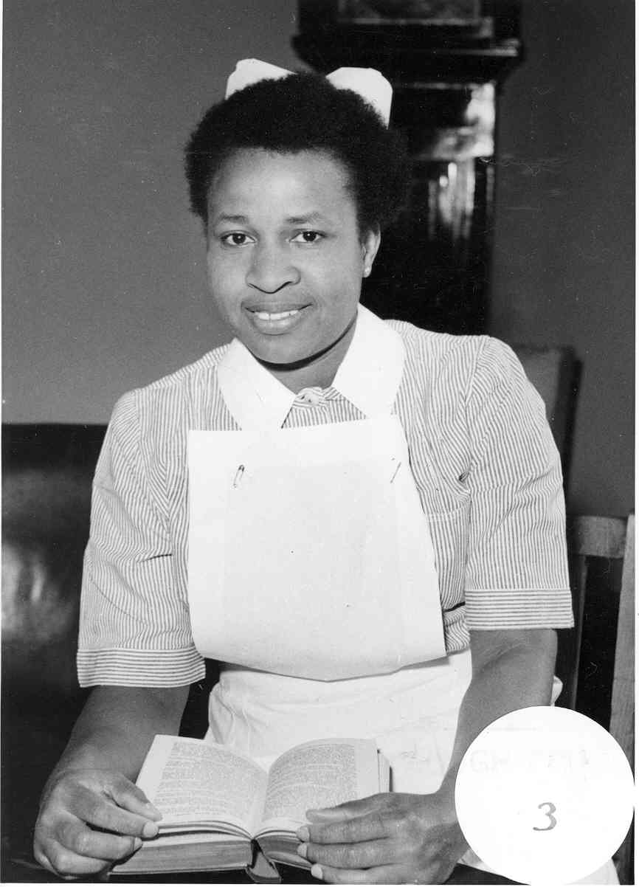
Notes:
Nurse on graduation day c1950 © RCN Archives

Slide 14
Notes:
P/18/2/80/3 Group of nurses Dudley Road Hospital 1947 (c) RCN Archives

Slide 15
Notes:
Nurses attending course in teaching methods for the nursing © RCN Archives

Slide 16
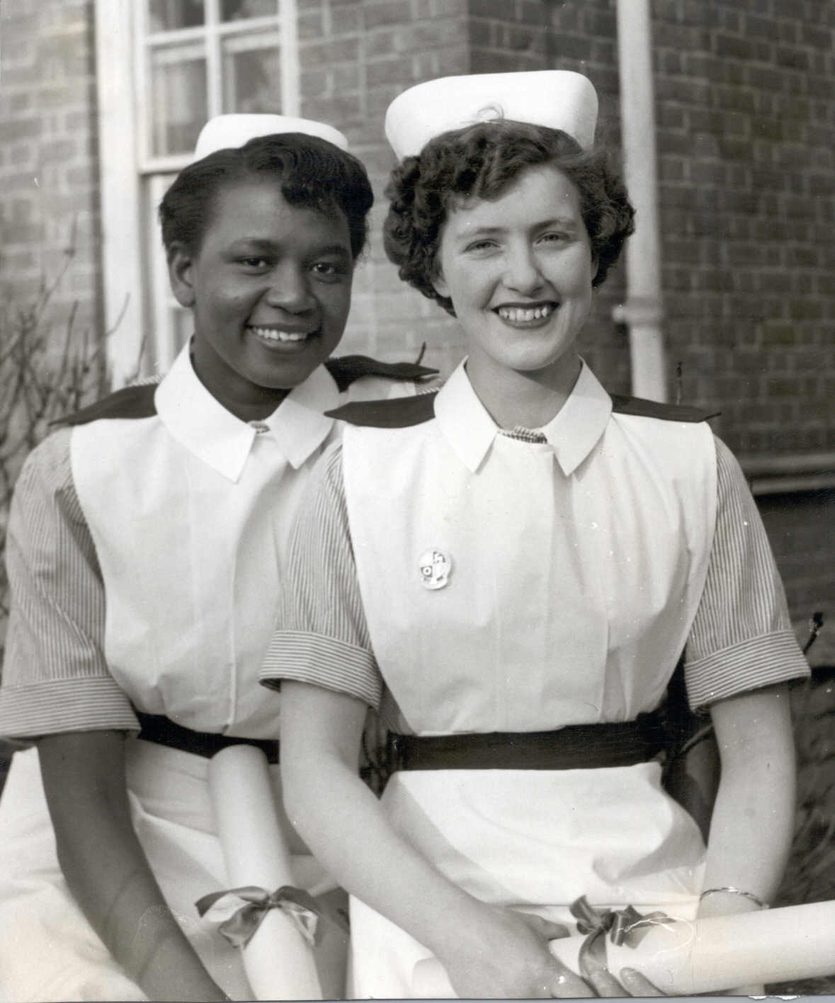
Notes:
P/18/2/33 Nurse Graduation, left from Sierra Leone, right from Donegal Ireland © RCN Archives

Slide 17
Inspirational Quotes
Please add to this section!
Please include the author and a reference in the notes section

Slide 18
Yvonne Coghill
Having a conversation about issues to do with race can take courage. Many of us run the risk of exposing our ignorance, offending someone with a prejudicial attitude, or demonstrating a racist attitude.
Notes:
https://blogs.bmj.com/ebn/2020/11/22/confronting-race-inequality-with-an-open-mind-and-open-heart/

Slide 19
Donna Kinnair
Equality is a problem for everyone in the health service. When there is racial inequality in the workplace, patient care suffers – and that is not acceptable.
Notes:
https://www.theguardian.com/commentisfree/2018/oct/01/black-nurse-nhs-doctors-nurses-prejudices

Slide 20
Elizabeth Anionwu
Have confidence in who you are as a black nurse and look for role models in literature, history and people you work with or have heard of, so you can see what others have done when you feel overwhelmed.
Notes:
https://www.rcn.org.uk/magazines/bulletin/2020/june/in-conversation-with-dame-elizabeth-anionwu

Slide 21
Cecilia Anim
When it comes to promotion, training and development, you feel that you have to work twice as hard to get to where you want to be. While others just walk through, you’re running, you’re breathless and you’re still not getting there.”
Notes:
https://humansofafrica.net/cecilia-anim-her-journey-to-become-first-black-woman-to-be-president-of-the-uks-royal-college-of-nursing/

Slide 22
Lenny Henry
"I'm growing impatient with this idea of tolerance because who wants to be tolerated?"
Notes:
Channel 4 News interview 7 November 2018
Channel 4 News on Twitter: ""I'm growing impatient with this idea of tolerance because who wants to be tolerated?" Sir Lenny Henry says he has changed his view on how tolerant Britain is because of his "frustration" over the lack of diversity in the television and film industry. https://t.co/4iemAgIV0R" / X

Slide 23
Lemn Sissay, poet
‘All racism is based on fear. So the less racist you are, the less fearful you become...’ -

Slide 24
Will-i-am – Black Eye Peas
Where is the love song lyric:
‘… But if you only have love for your own race Then you only leave space to discriminate’

Slide 25
Mahatma Gandhi
Our ability to reach unity in diversity will be the beauty and the test of our civilisation.

